Slide 1


Slide 2
Hello!
I am KEVIN
You can find me at:
@kevinmaske
linkedin

Slide 3
STATISTICS
Insighting from data

Slide 4
Overview
Introduction
Describing Data
Randomness
LUNCH BREAK
Distributions
Sampling
Hypothesis Testing
Confusion Matrix

Slide 5

Introduction
How much should a family budget on rice for a week?
500

Slide 6
Introduction
How much should a family budget on rice for a week?
500, 300

Slide 7
Introduction
How much should a family budget on rice for a week?
500, 300, 362, 498, 563

Slide 8
Introduction
How much should a family budget on rice for a week?
164 97 99 59 64 476 423 252 103 27 335 148 259 22 190 140 213 473 277 304 56 95 257 81 40 23 463 23 354 237 245 397 338 181 234 149 132 395 144 474 399 27 353 412 392 1229 163 114 160 38 140 473 429 344 88 473 439 94 260 82 347 251 166 239 173 105 430 74 377 44 210 8 105 199 32 103 465 175 183 449 458 239 61 45 408 274 97 387 56 182 125 221 339 372 125 290 246 399 391 355 493 310 180 73 99 261 197 146 197 8 299 476 39 227 350 298 84 293 51 479 357 326 365 206 109 453 408 13 101 136 213 112 220 412 98 305 432 66 460 285 256 415 107 184 334 292 319 277 118 483 301 79 138 75 271 434 355 362 212 109 227 143 5 286 77 394 458 348 36 356 360 349 366 458 125 155 119 158 73 269 241 391 89 274 269 401 465 365 228 41 494 125 87 267 82 117 268 64 440 201 88 307 372 447 465 217 417 108 123 148 389 477 379 175 48 199 348 296 290 278 361 64 37 252 79 122 274 290 485 721 344 264 496 260 48 467 415 367 143 455 333 477 237 229 165 382 454 87 36 106 120 370 97 174 436 158 293 779 493 155 285 306 314 429 225 429 443 179 192 353 402 142 281 832 264 500 364 275 370 139 471 179 425 88 367 352 470 418 329 391 351 496 430 126

Slide 9
Introduction
STATISTICS
Describing, Presenting, and Analyzing Data

Slide 10

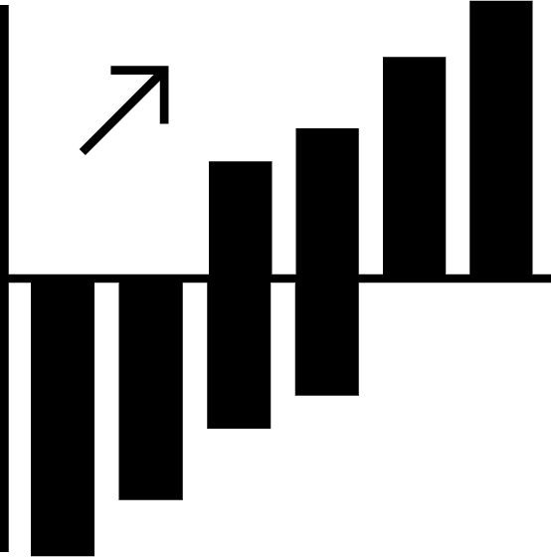
Introduction
STATISTICS
Describing, Presenting, and Analyzing Data
a
12%
Number
Table
Chart

Slide 11


Describing Data: Metrics
Centrality
Dispersion

Slide 12
Describing Data: Metrics
Mean
(add all values, then divide by # of values)
Median
(sort values in [ascending] order, get middle (or average of middle)
Mode
(get most frequent value[s])
Centrality

Slide 13
Describing Data: Metrics
Mean
the “arithmetic” average. The average value.
Median
the “positional” average. The middle value.
Mode
the “frequency” average. The most frequent value.
Centrality

Slide 14
Describing Data: Metrics
How much should a family budget on rice for a week?
(for simplicity, assume figures are in 00’s)
2, 4, 4, 4, 5, 6.5, 7.5, 9, 9

Slide 15
Describing Data: Metrics
How much should a family budget on rice for a week?
(for simplicity, assume figures are in 00’s)
2, 4, 4, 4, 5, 6.5, 7.5, 9, 9
Mean = 5.67
Median = 5
Mode = 4

Slide 16
Describing Data: Metrics
How much should a family budget on rice for a week?
(for simplicity, assume figures are in 00’s)
3, 3.5, 4, 5.5, 7, 8, 8, 9, 9, 9.5, 10, 10.5

Slide 17
Describing Data: Metrics
How much should a family budget on rice for a week?
(for simplicity, assume figures are in 00’s)
3, 3.5, 4, 5.5, 7, 8, 8, 9, 9, 9.5, 10, 10.5
Mean = 7.25
Median = 8
Mode = 8,9

Slide 18
Describing Data: Metrics
Mean
(add all values, then divide by # of values)
Median
(sort values in [ascending] order, get middle (or average of middle)
Mode
(get most frequent value[s])
Centrality

Slide 19
Describing Data: Metrics
Mean
A good first option, and the most commonly used
Median
Usually appropriate when data has extreme values
Mode
Generally used for non-numeric data
Centrality

Slide 20
Describing Data: Metrics
Centrality
Dispersion

Slide 21
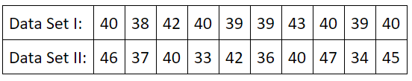
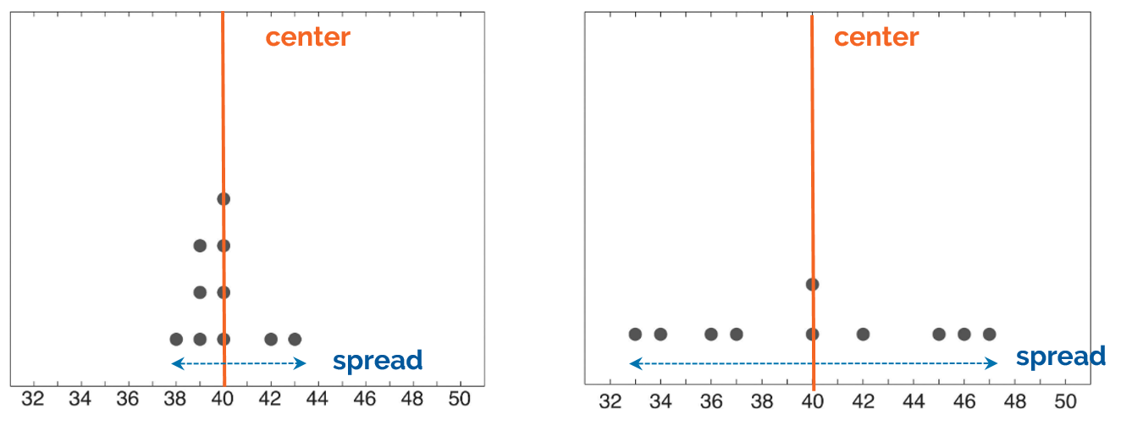
Describing Data: Metrics
Dispersion describes how spread out the data is
Dispersion

Slide 22
Describing Data: Metrics
Why is knowing and describing variability important?
Dispersion

Slide 23
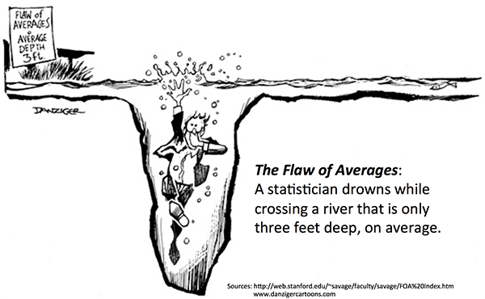
Describing Data: Metrics
Dispersion

Slide 24
Describing Data: Metrics
Range
Looks at total span of your dataset.
Quartiles
Looks at how concentrated your dataset is in different parts
Variance and Standard Deviation
Measures dispersion of data around your (arithmetic) mean
Dispersion

Slide 25
Describing Data: Metrics
Range
MAX - MIN
Quartiles
Sort data in [ascending] order, and find values that cut data into 4 parts
Variance (and Standard Deviation)
Average of squared differences between mean and each data point
Dispersion

Slide 26
Describing Data: Metrics
How much should a family budget on rice for a week?
(for simplicity, use denominator n for variance)
3, 3.5, 4, 5.5, 7, 8, 8, 9, 9, 9.5, 10, 10.5
Range: 7.5
Quartiles: 4.75, 8, 9.25
Var: 6.35
SD: 2.52

Slide 27
Introduction
STATISTICS
Describing, Presenting, and Analyzing Data
a
12%
Number
Table
Chart

Slide 28
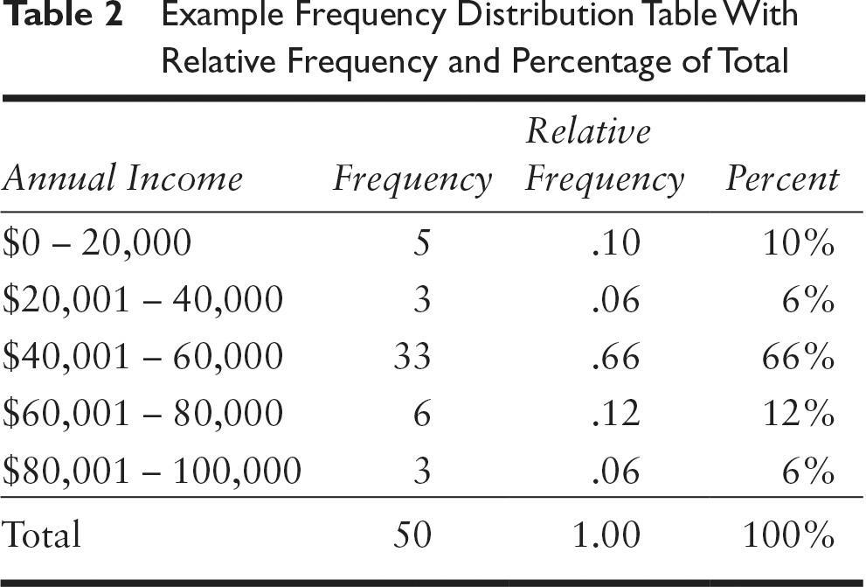
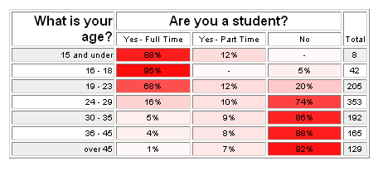
Describing Data: Tables
Frequency Tables
Cross-tabulations

Slide 29
Describing Data: Tables
Size of Family | Weekly Rice Allowance
3 | 350
3 | 300
3 | 250
3 | 350
3 | 300
5 | 450
5 | 550
5 | 350
5 | 600
5 | 500

Slide 30
Describing Data: Tables
Size of Family | Weekly Rice Allowance
3 | 350
3 | 300
3 | 250
3 | 350
3 | 300
5 | 450
5 | 550
5 | 350
5 | 600
5 | 500
Family Size | Average Weekly Rice Allowance | Standard Deviation (Denom. = n)
3 | 310 | 37.42
5 | 490 | 86.02

Slide 31
Introduction
STATISTICS
Describing, Presenting, and Analyzing Data
a
12%
Number
Table
Chart

Slide 32
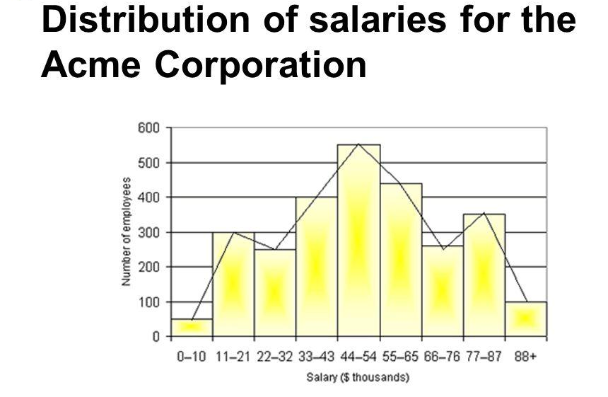

Describing Data: Charts
Graphical presentation of data
Histogram
Bar
Boxplot
Line
Scatterplot

Slide 33
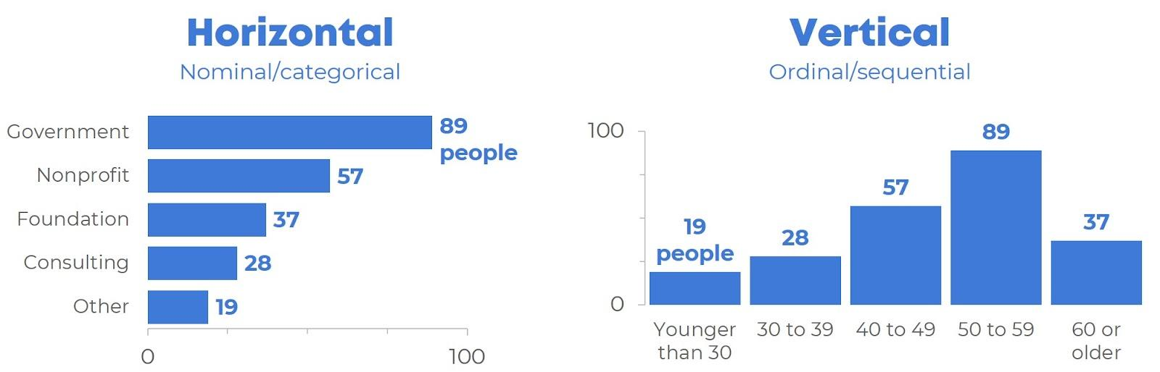
Describing Data: Charts
Graphical presentation of data
Histogram
Bar
Boxplot
Line
Scatterplot

Slide 34
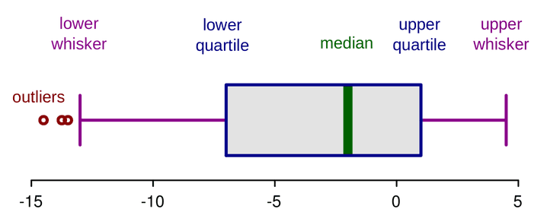
Describing Data: Charts
Graphical presentation of data
Histogram
Bar
Boxplot
Line
Scatterplot

Slide 35
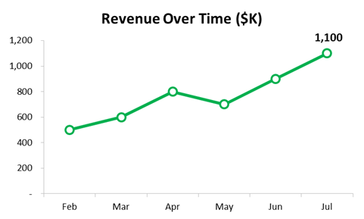
Describing Data: Charts
Graphical presentation of data
Histogram
Bar
Boxplot
Line
Scatterplot

Slide 36
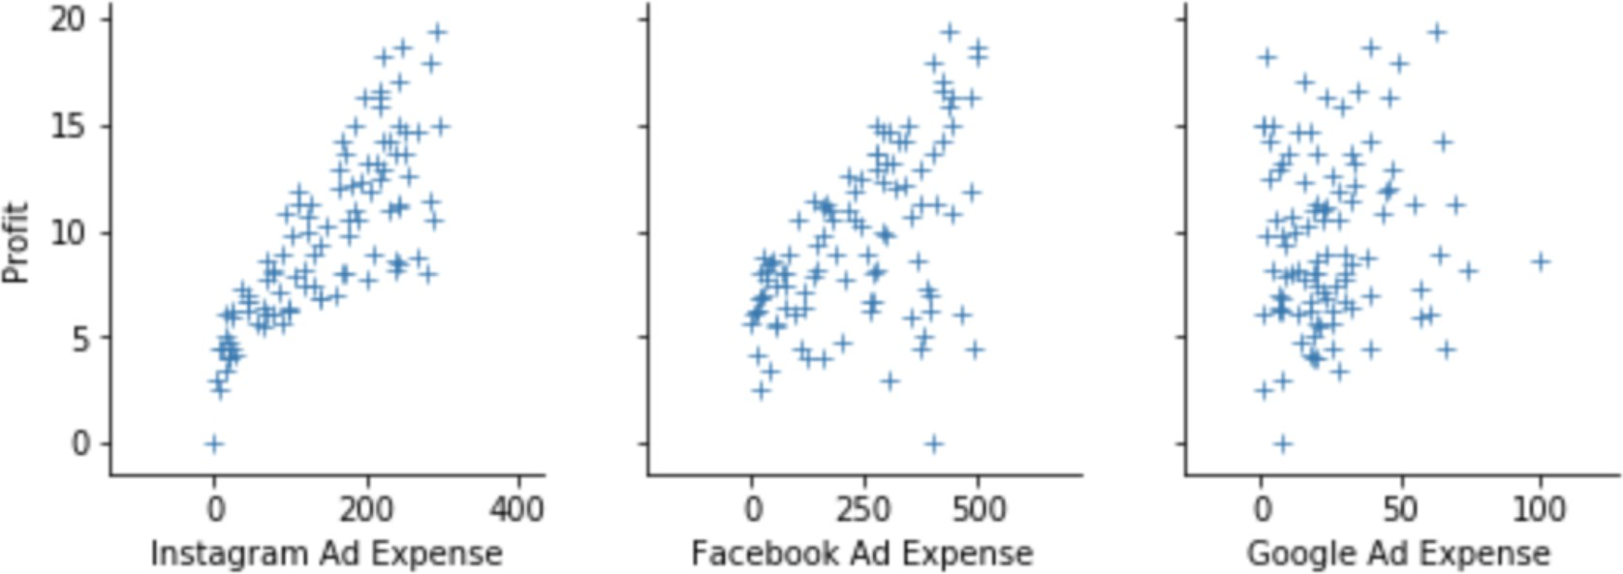
Describing Data: Charts
Graphical presentation of data
Histogram
Bar
Boxplot
Line
Scatterplot

Slide 37
Scatter Plots and Correlations
SUPPOSE you’re handling media spend
for your digital marketing.
What insight(s) can we get from the plots above?

Slide 38
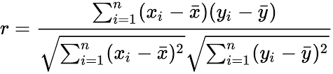

Scatter Plots and Correlations
Pearson Correlation Coefficient
Quantifies the strength of linear relationship that exist between two variables or between the predictor and the response variable.

Slide 39
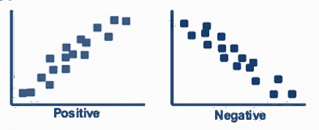
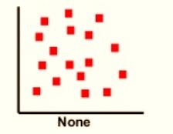
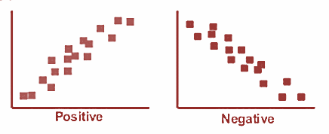
Scatter Plots and Correlations
Direction and Strength of Correlation
Correlation Coefficient | Levels
1.00 | Perfect
0.99 – 0.90 | Near to perfect
0.89 – 0.75 | Strong
0.74 – 0.45 | Moderate
0.44 – 0.20 | Weak
0.19 – 0.10 | Near to none
0.09 – 0.00 | None
+1
0
If the correlation value is negative then the relationship is negative.
If the correlation value is positive then the relationship is positive.
-1

Slide 40
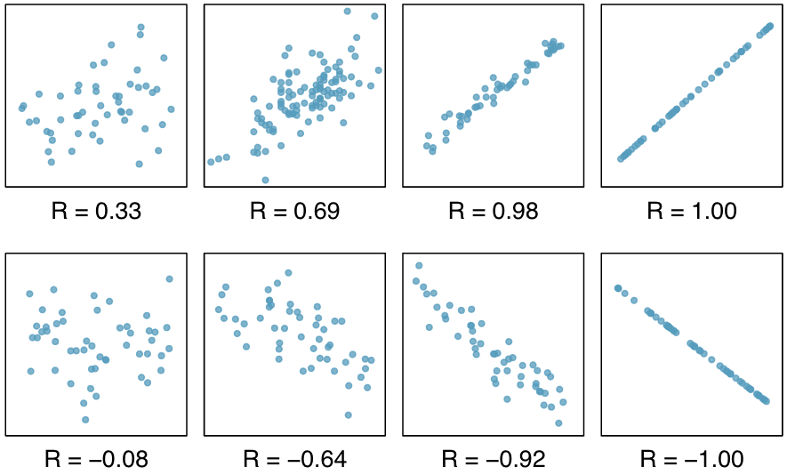
Scatter Plots and Correlations
Direction and Strength of Correlation

Slide 41
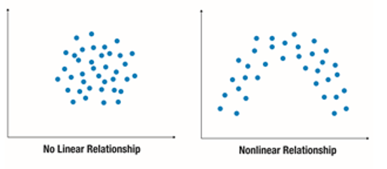
Scatter Plots and Correlations
Some relationships are nonlinear

Slide 42

Is it enough
to stop here?

Slide 43
RANDOMNESS
Qualifying Insights

Slide 44
General Concepts
ALL DATA IS GENERATED BY PROCESSES
Data
Amount spent in Grocery Store
Basketball Team Stats
Election Results
Your quiz score
Process
Shopping in groceries
Games being played

Slide 45


Randomness
Deterministic Process
Stochastic Process

Slide 46
Randomness
We can (generally) define a set of possible outcomes
Each outcome (or set of outcomes) is referred to as an "event"
We refer to the likelihood of some event occurring as its probability
Stochastic Process

Slide 47
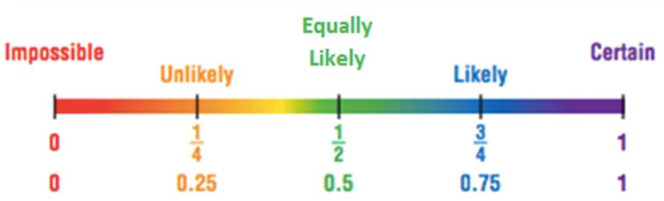
Randomness
For a given process, the probability of each event will be between 0 and 1 (inclusive)
The sum of the probability of all mutually exclusive events that make up the entire "sample space" must be 1
Stochastic Process

Slide 48
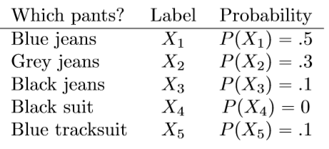
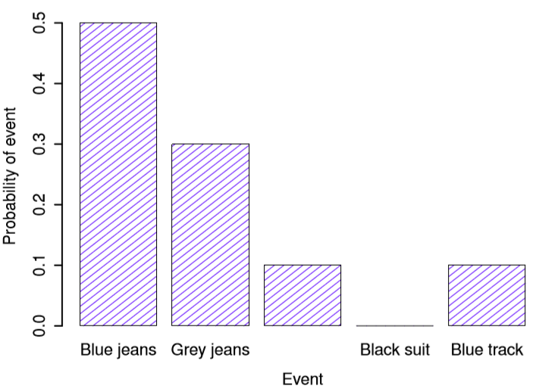
A random variable assigns unique values to the outcomes of a random experiment. A probability distribution assigns probabilities to each possible value of a random variable.
Probability

Slide 49
A more concrete example. Random variable X is defined as the number of children per family.
Probability
X | 2 | 3 | 4 | 5 | 6 | 7 | 8 | 9 | 10 | 11 | 12
P(x) | 0.03 | 0.06 | 0.08 | 0.11 | 0.14 | 0.16 | 0.14 | 0.11 | 0.08 | 0.06 | 0.03

Slide 50
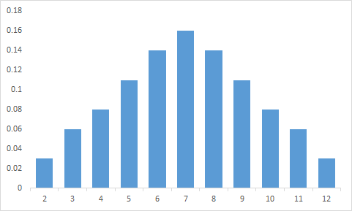
A probability distribution can also be presented as a histogram.
Probability
X | 2 | 3 | 4 | 5 | 6 | 7 | 8 | 9 | 10 | 11 | 12
P(x) | 0.03 | 0.06 | 0.08 | 0.11 | 0.14 | 0.16 | 0.14 | 0.11 | 0.08 | 0.06 | 0.03

Slide 51

Probability
How do
we assign probabilities?

Slide 52
Probability
Classical
Assumes each event in the sample space has equal probability.
Frequentist
Probabilities are weighted based on their frequency in data.
Bayesian
Probabilities are a mix of evidence from data and prior belief.

Slide 53


Classical Probability
Classical Probability

Slide 54
Classical Probability
A 6-sided die is rolled.
Find the probability that an even number is obtained.

Slide 55

Classical Probability
Two coins are tossed.
Find the probability that two heads are obtained.

Slide 56
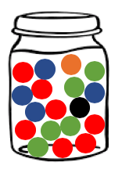
Classical Probability
A jar contains 7 red marbles, 5 green, 4 blue, 1 orange and 1 black. A marble is drawn from the jar at random.
What is the probability that this marble is
Blue?
Red?
Not green or red?
P(blue) = 0.22
P(red) = 0.39
P(not (green or red)) = 0.33

Slide 57
Frequentist Probability
Suppose that instead of a transparent jar, the jar is completely opaque, and we’re only allowed to draw one ball at a time before putting it back in.
How can we get the probability of drawing a red ball (at random)?

Slide 58
Frequentist Probability
Red Red Red Blue Blue Red Blue Black Green Red Green Blue Red Green Black Blue Blue Red
Out of 18 trials, we got red 7 times
_{P(Red) = 7/18 = 0.3889}

Slide 59
Frequentist Probability
Red Red Red Blue Blue Red Blue Black Green Red Green Blue Red Green Black Blue Blue Red
_{P(Red) = 7/18 = 0.3889}
_{P(Blue) = 6/18 = 0.3333}
_{P(Green) = 3/18 = 0.1667}
_{P(Black) = 2/18 = 0.1111}
_{P(Orange) = 0/18 = 0.0000}

Slide 60
Probability
Concepts and Common Distributions

Slide 61
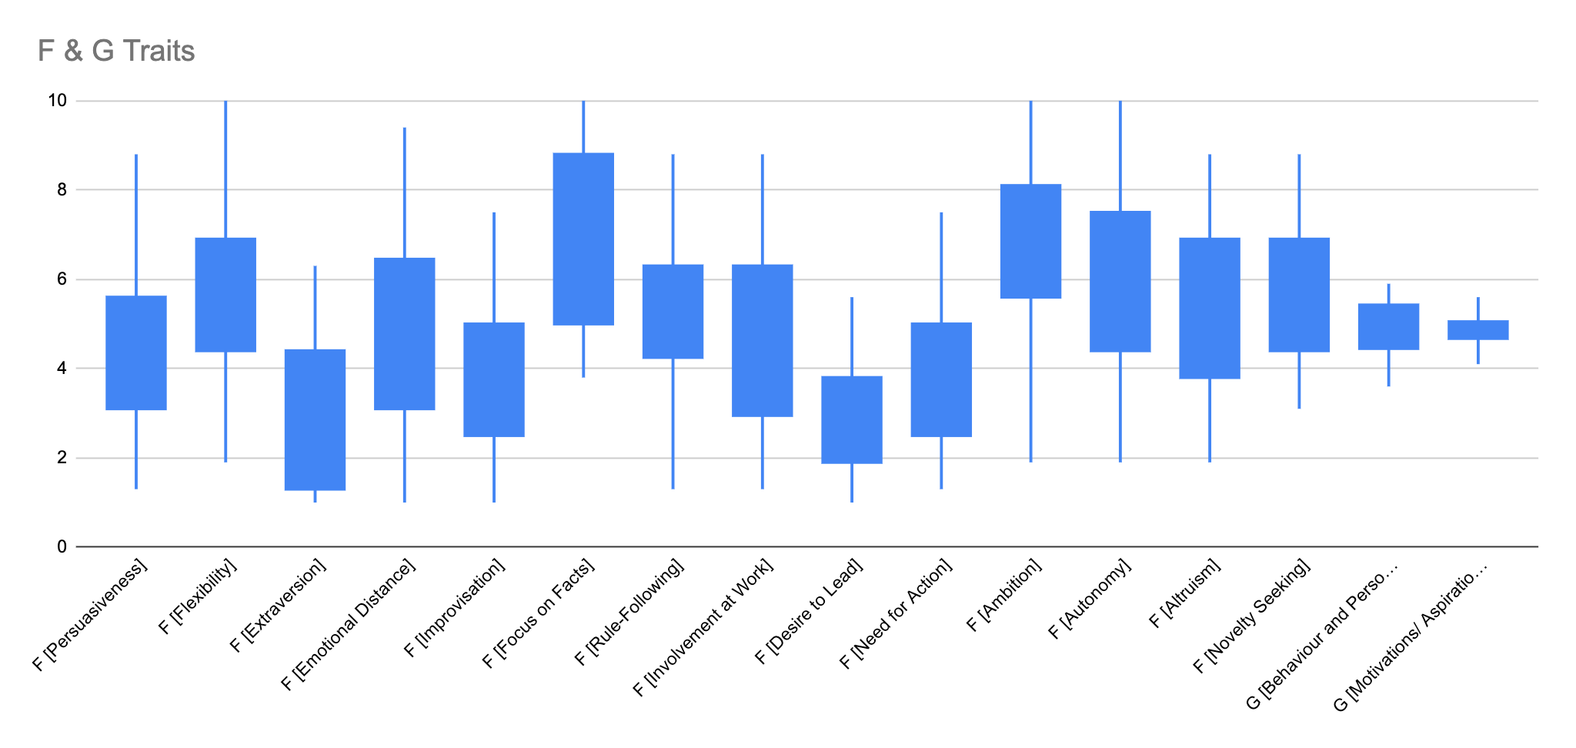
GLEAC B6 Benchmark

Slide 62
A random variable assigns unique values to the outcomes of a random experiment. A probability distribution assigns probabilities to each possible value of a random variable.
Distributions

Slide 63
The Expected Value is the average value of a r.v. (given many trials). Alternatively: the probability-weighted average of the distribution.
The Variance (and St.Dev.) remains the probability weighted average of the squared differences between each value and the E.V. (st.dev is sq. root).
How do we get the expected value if we’re using the frequentist method?
Distributions

Slide 64

Secret Die Problem:
Suppose you have a magical box that is completely opaque, but has a button. Every time you press the button, a die inside will be rolled, and the result will be displayed.
You don’t know how many sides the die has, nor if it’s even a fair die.
How can you determine the expected value of a single die roll?
Distributions

Slide 65
Distributions
Bernoulli/Binomial
The output variable that we’re trying to predict has only two outcomes and the probability of each outcome are the same in all the successive trials/observations.
Email classification: spam or ham
Fraud detection: fraud or not fraud
Cancer detection: benign or malignant
Image classification: cat vs not a cat
Quality control: defective vs non defective
*Binomial distribution is the sum of bernoulli trials

Slide 66
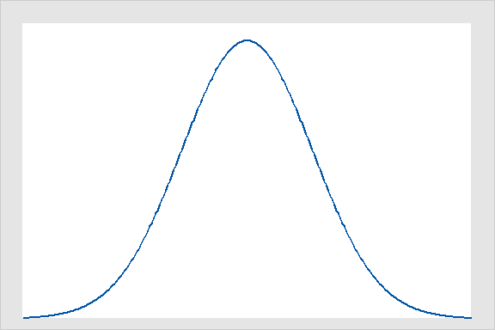
Distributions
Normal
Also known as Gaussian.
Most common distribution.
Predicting house prices in New York
Predicting income of NFL players
Estimating sales from Facebook ads
Predicting amount of transaction upon check out.
Normal Distribution

Slide 67
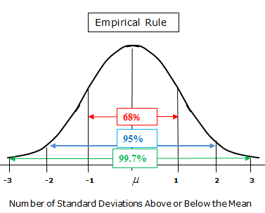
Distributions
Empirical Rule
Approximately 68% of all of the points are within the range -1 to 1 standard deviation.
About 95% of all of the points are within the range -2 to 2 standard deviations.
About 99.7% of all of the points are within the range -3 to 3 standard deviations.

Slide 68
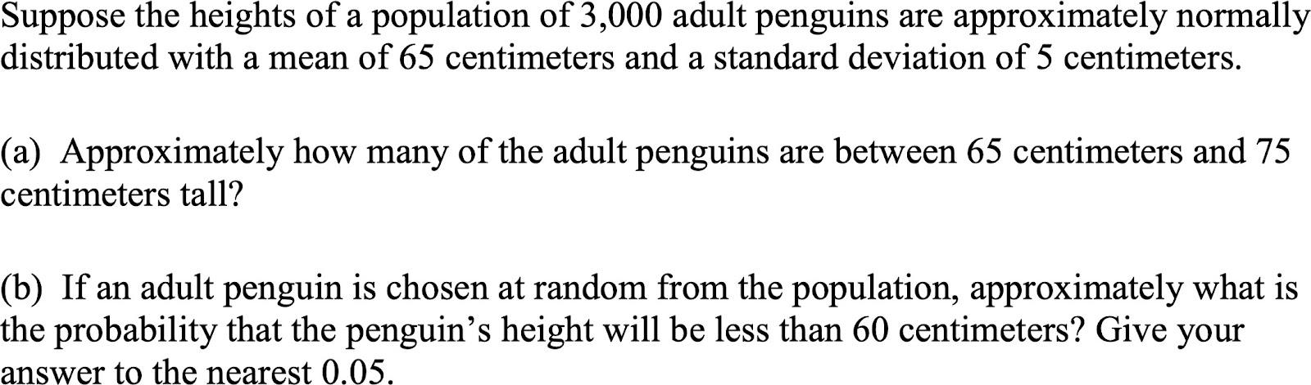
Distributions
Example

Slide 69
Is it enough
to stop here?

Slide 70


With no other information aside
from what’s presented below,
WHICH WOULD YOU SELECT?
A
B

Slide 71
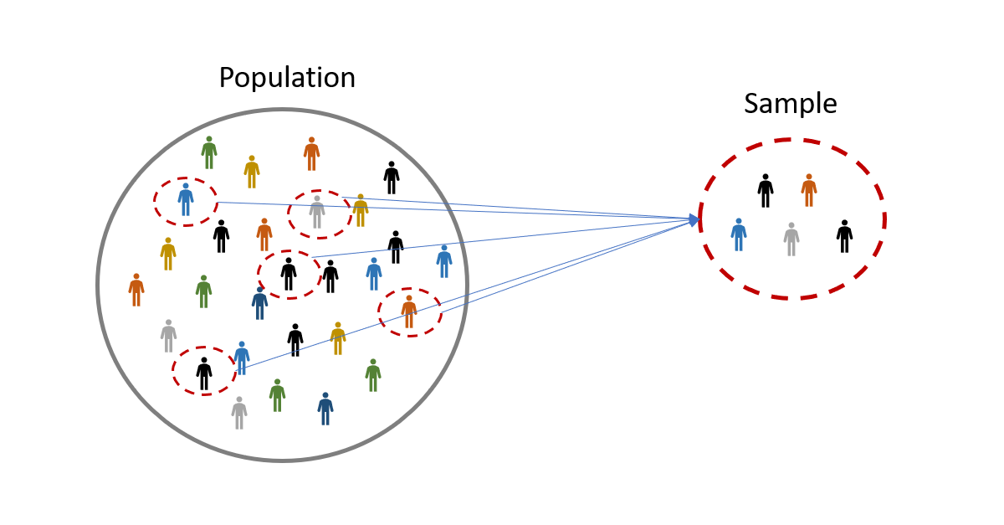
Sampling
Is the population mean RANDOM?

Slide 72
Sampling
Is a sample mean RANDOM?

Slide 73
Sampling
mean_1
mean_2
Sample metrics ARE random, and in fact, the samples themselves are random!
Each (sample) metric is a RANDOM VARIABLE and has a RANDOM DISTRIBUTION
mean_3
mean_4

Slide 74
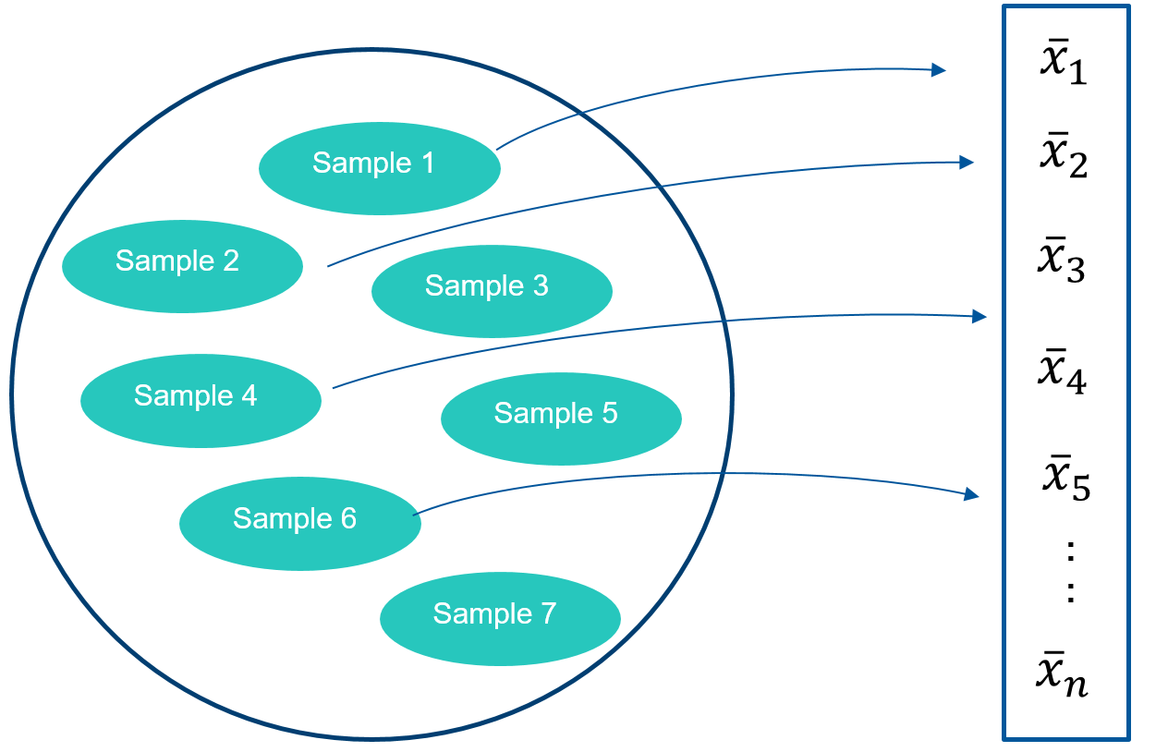

Sampling
Central Limit Theorem (CLT)
Sample means are normally distributed.
Normal Distribution

Slide 75
Sampling
Law of Large Numbers
As sample size increases, the sample mean approaches the population mean

Slide 76
Hypothesis Testing
Formulate your (competing) hypotheses
Compute the metrics of interest for your data set(s)
Evaluate the p-value of your test

Slide 77
Hypothesis Testing
Our insights will generally be assertions, and these assertions will be the hypotheses that we test:
Hypothesis: The average age of people on earth is 60 years old
Hypothesis: People with higher educational attainment are more likely to be employed than those with lower attainment.

Slide 78
Hypothesis Testing
For hypothesis testing, you’ll be checking your assertion against a baseline assumption.
NULL HYPOTHESIS: Assumes that your assertion isn’t true
ALTERNATIVE HYPOTHESIS: Assumes that your assertion is true

Slide 79
Hypothesis Testing
For hypothesis testing, you’ll be checking your assertion against a baseline assumption.
NULL HYPOTHESIS:
The average age of people in the world is not 60 years
ALTERNATIVE HYPOTHESIS:
The average age of people in the world is 60 years.

Slide 80
Hypothesis Testing
For hypothesis testing, you’ll be checking your assertion against a baseline assumption.
NULL HYPOTHESIS:
<average age> != 60
ALTERNATIVE HYPOTHESIS:
<average age> = 60

Slide 81
Hypothesis Testing
For hypothesis testing, you’ll be checking your assertion against a baseline assumption.
NULL HYPOTHESIS:
<average age> - 60 != 0
ALTERNATIVE HYPOTHESIS:
<average age> - 60 = 0

Slide 82
Hypothesis Testing
For hypothesis testing, you’ll be checking your assertion against a baseline assumption.
Compute your metric:
Here, we’re concerned with average age, so assume you get 1M people’s ages, and end up with a dataset of ages that has a mean of 40 and a standard deviation of 10.
Based on the inequalities here, we’re concerned with the metric <mean> - 60.
NULL HYPOTHESIS:
<average age> - 60 != 0
ALTERNATIVE HYPOTHESIS:
<average age> - 60 = 0

Slide 83
Hypothesis Testing
Core Question of Hypothesis Testing:
If we live in a world where the null hypothesis is true, what’s the probability that your sample gave you the results that it did?
Assume we get age samples with an average of 40 (with a standard deviation of 10). How likely is it that the sample you got had an average age of 60?

Slide 84
Hypothesis Testing
For hypothesis testing, you’ll be checking your assertion against a baseline assumption.
NULL HYPOTHESIS:
<average age> - 60 != 0
ALTERNATIVE HYPOTHESIS:
<average age> - 60 = 0

Slide 85
Hypothesis Testing
For hypothesis testing, you’ll be checking your assertion against a baseline assumption.
Compute your metric:
Here, we’re concerned with average age, so assume you get 1M people’s ages, and end up with a dataset of ages that has a mean of 40 and a standard deviation of 10.
Based on the inequalities here, we’re concerned with the metric <mean> - 60.
NULL HYPOTHESIS:
<average age> - 60 != 0
ALTERNATIVE HYPOTHESIS:
<average age> - 60 = 0

Slide 86
Hypothesis Testing
For hypothesis testing, you’ll be checking your assertion against a baseline assumption.
NULL HYPOTHESIS:
<40> - 60 != 0
ALTERNATIVE HYPOTHESIS:
<40> - 60 = 0
If the ages we get are normally distributed, then
[T = <ages> - 60] is still normally distributed, and with the same standard deviation (10).
If we assume the null hypothesis is true, then T follows N(0, 10).

Slide 87
Hypothesis Testing
Core Question of Hypothesis Testing:
If we live in a world where the null hypothesis is true, what’s the probability that your sample gave you the results that it did?
Assume T ~ N(0, 10). What’s the probability that (at most) T = -20?

Slide 88
Hypothesis Testing
p-value
The probability of your collected data occurring (along with any resulting statistics) under the null hypothesis.
What does a low p-value indicate?
What does a high p-value indicate?
For which p-values should we reject the null hypothesis?

Slide 89
Hypothesis Testing
Significance Level
A threshold that indicates when a p-value is
considered significant.
Common thresholds are 0.05 and 0.01.

Slide 90
Hypothesis Testing
Example 1:
From the data, it looks like correlation between age and the probability of purchasing insurance is high, at 0.80.
What is the null hypothesis?
What is the alternative hypothesis?
My computations showed that my alternative hypothesis had a p-value of 0.07. Is this significant at a 5% level of significance?

Slide 91
Hypothesis Testing
Example 2:
From the data, it seems like people aged below 22 are more prone to acne than those aged above.
What is the null hypothesis?
What is the alternative hypothesis?
My computations showed that my alternative hypothesis had a p-value of 0.01. Is this significant at a 5% level of significance?
What do I conclude?

Slide 92
Test of Means (with known Variance)
You want to know if families in Pasig City spend more on rice (per week) than families in Cebu City.
Using what we’ve done on hypothesis testing so far, what might your hypotheses be?

Slide 93
Test of Means (with known Variance)
You want to know if families in Pasig City spend more on rice (per week) than families in Cebu City.
Using what we’ve done on hypothesis testing so far, what might your hypotheses be?
NULL HYPOTHESIS (will always have equality):
R_m <= R_c
ALTERNATIVE HYPOTHESIS:
R_m > R_c

Slide 94
Test of Means (with known Variance)
You want to know if families in Pasig City spend more on rice (per week) than families in Cebu City.
Using what we’ve done on hypothesis testing so far, what might your hypotheses be?
NULL HYPOTHESIS (will always have equality):
R_m - R_c <= 0
ALTERNATIVE HYPOTHESIS:
R_m - R_c > 0

Slide 95
Test of Means (with known Variance)
You want to know if families in Pasig City spend more on rice (per week) than families in Cebu City.
Using what we’ve done on hypothesis testing so far, what might your hypotheses be?
Suppose that, based on your research, you found that weekly spending in Pasig and Cebu on rice per family followed the below distributions:
Weekly Spend in Pasig ~ N(340, 100)
Weekly Spend in Cebu ~ N(310, 50)

Slide 96
Test of Means (with known Variance)
You want to know if families in Pasig City spend more on rice (per week) than families in Cebu City.
Using what we’ve done on hypothesis testing so far, what might your hypotheses be?
Metric of Interest:
R_m - R_c = T = 340 - 310
and T ~ N(?, 150)

Slide 97
Test of Means (with known Variance)
T ~ N(0, 150), data gives T = 30
NULL HYPOTHESIS
T <= 0
ALTERNATIVE HYPOTHESIS:
T > 0
T = 30

Slide 98
Test of Means (with known Variance)
T ~ N(0, 150), data gives T = 30
NULL HYPOTHESIS
T <= 0
ALTERNATIVE HYPOTHESIS:
T > 0
T = 30
P(T > 30) = 0.0072

Slide 99
Types of Error
Significance Level
A threshold that indicates when a p-value is
considered significant.
Common thresholds are 0.05 and 0.01.

Slide 100
Types of Error
Significance Level
A threshold that indicates when a p-value is
considered significant.
Common thresholds are 0.05 and 0.01.
What are some interpretations for significance level? What do 0.05 or 0.01 represent?

Slide 101

Types of Error
Assume our significance level is alpha (α) = 0.05, and we have our test statistic (which is RANDOM).
What is the chance that we incorrectly reject the null hypothesis?

Slide 102
Types of Error
TYPE I ERROR
Incorrectly rejecting the null hypothesis /
Incorrectly accepting the alternative hypothesis
TYPE II ERROR
Incorrectly accepting the null hypothesis /
Incorrectly rejecting the alternative hypothesis

Slide 103
Types of Error
FALSE POSITIVE
Incorrectly rejecting the null hypothesis /
Incorrectly accepting the alternative hypothesis
FALSE NEGATIVE
Incorrectly accepting the null hypothesis /
Incorrectly rejecting the alternative hypothesis

Slide 104
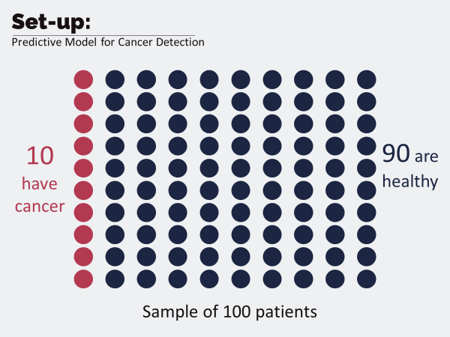
Types of Error
Suppose for your project, your team is building a model that diagnoses cancer in a patient.
Those who have cancer are called CASES, and those who are healthy are called CONTROLS.

Slide 105
Types of Error
Given a certain model that does these predictions, how can we evaluate them? (i.e. how would you propose we measure how accurate the models are?)

Slide 106
Types of Error
Our model correctly diagnosed 5 out of the 10 cases, while classifying the remaining 95 as controls….
(5+90)/100 = 95%

Slide 107
Types of Error
MODEL A
Classification Accuracy: 90%
MODEL B
Classification Accuracy: 90%

Slide 108
Types of Error
MODEL A
Classification Accuracy: 90%
Diagnosed ALL SAMPLES as HEALTHY (control)
MODEL B
Classification Accuracy: 90%
Successfully diagnosed 4/10 cases, and 85/90 controls

Slide 109
Types of Error
MODEL A
Classification Accuracy: 90%
Diagnosed ALL SAMPLES as HEALTHY (control)
MODEL B
Classification Accuracy: 90%
Successfully diagnosed 4/10 cases, and 85/90 controls
How many Type I and II errors did each model make?

Slide 110
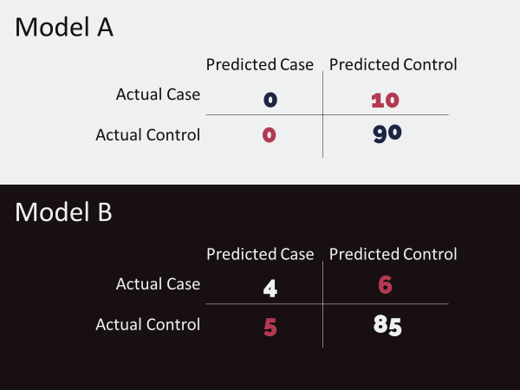
Types of Error
MODEL A
Classification Accuracy: 90%
Diagnosed ALL SAMPLES as HEALTHY (control)
MODEL B
Classification Accuracy: 90%
Successfully diagnosed 4/10 cases, and 85/90 controls
How many Type I and II errors did each model make?

Slide 111
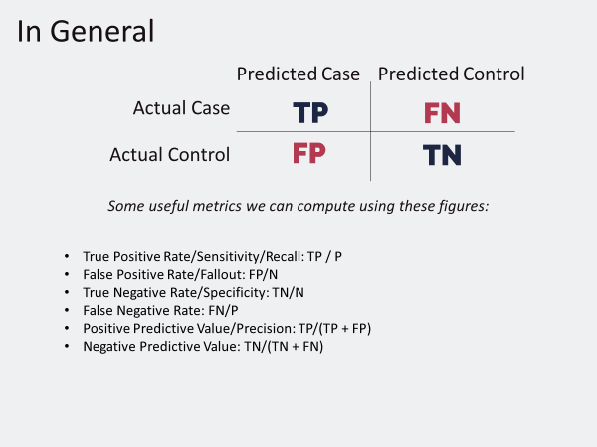
Types of Error
When you build your (classification models), how do you decide which of these metrics is (most) important?

